Slide 1
Advanced EC2
Advance topic of EC2 will be covered in this section

Slide 2
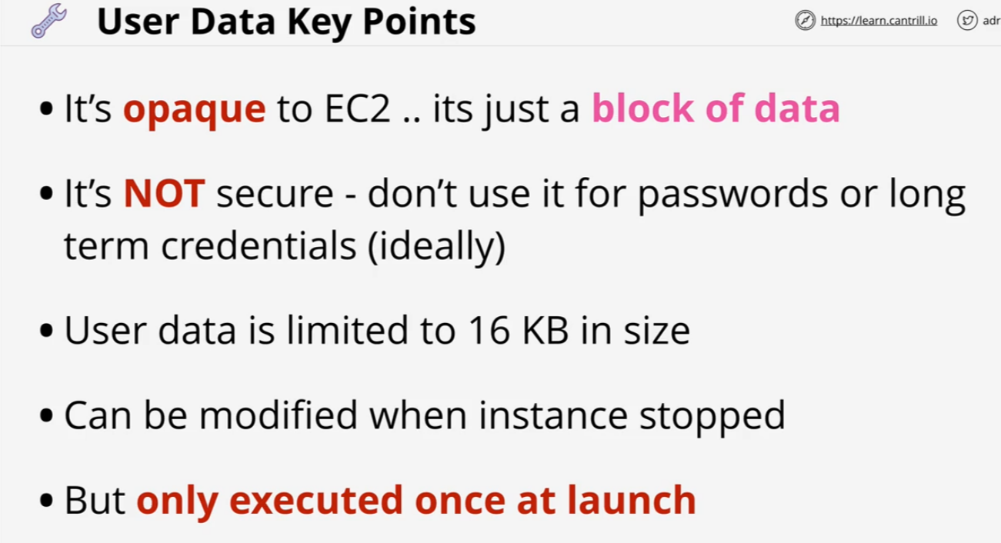
User Data Key Points

Slide 3
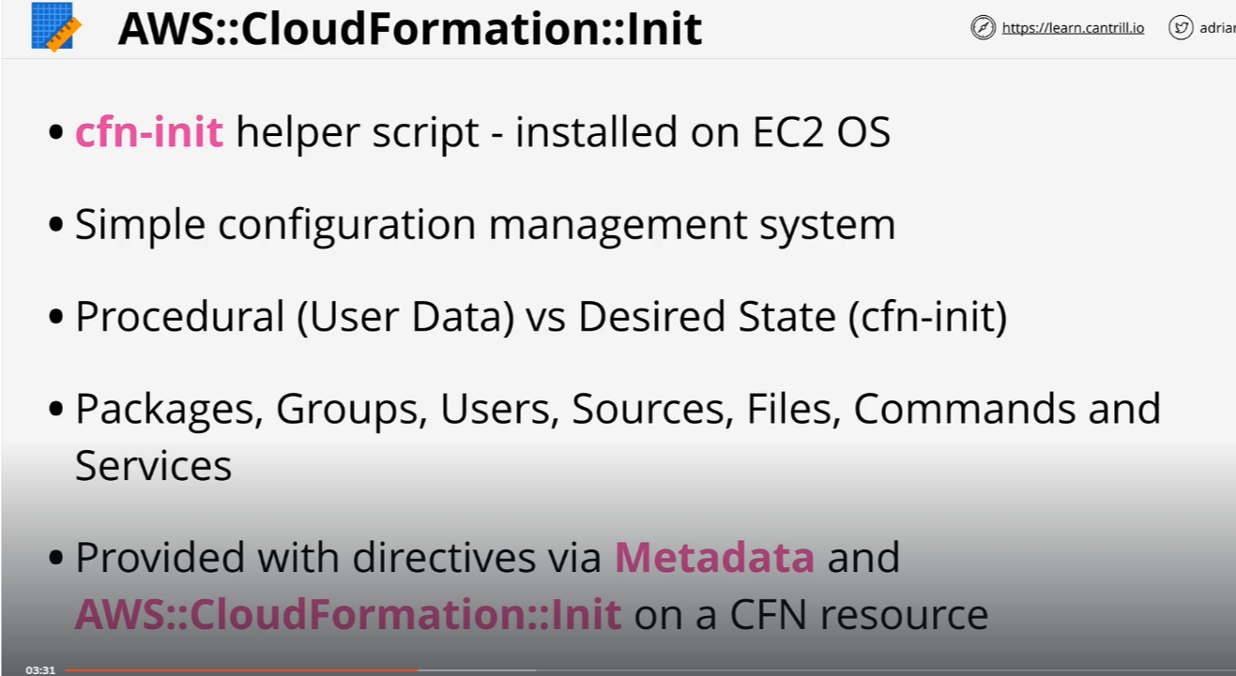
Bootstrapping with CFN-INIT

Slide 4
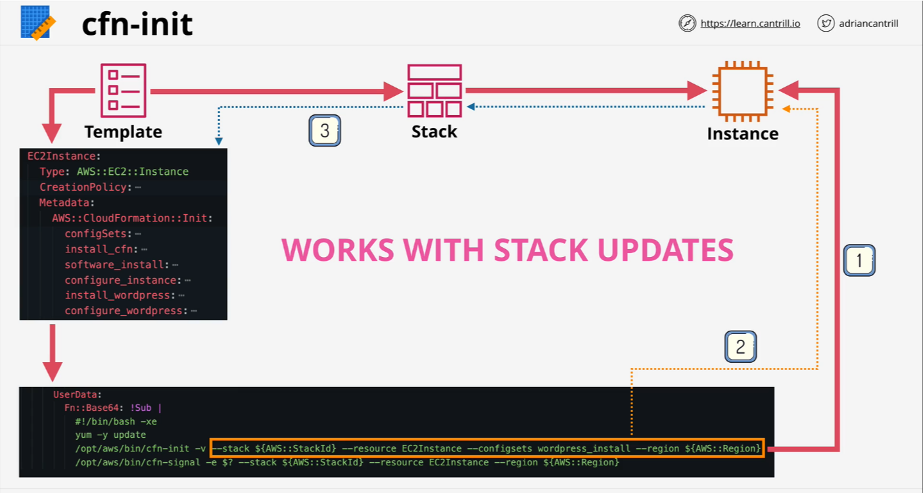
Bootstrapping with CFN-INIT

Slide 5
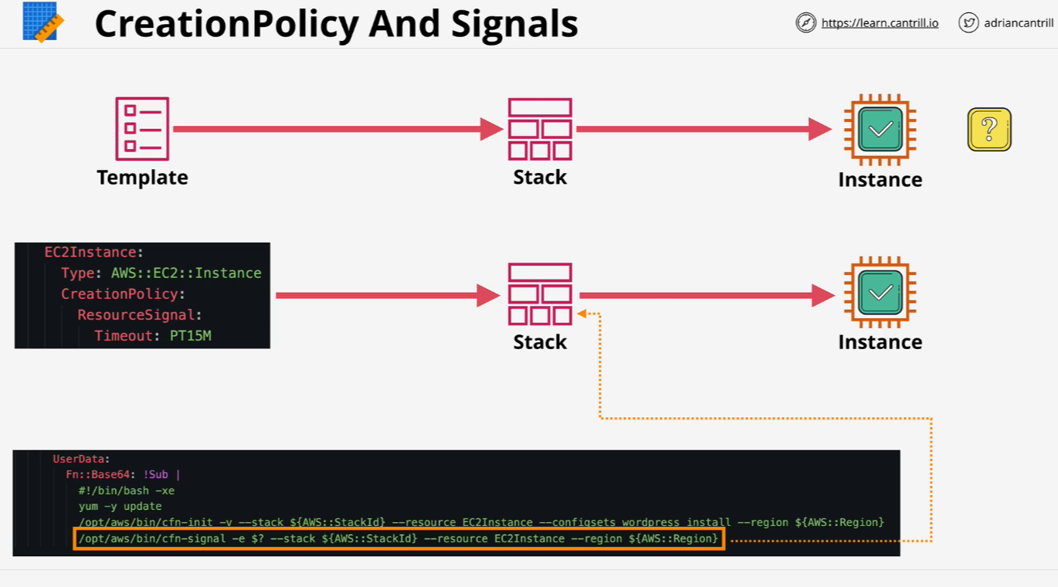
Creation Policy And Signal

Slide 6
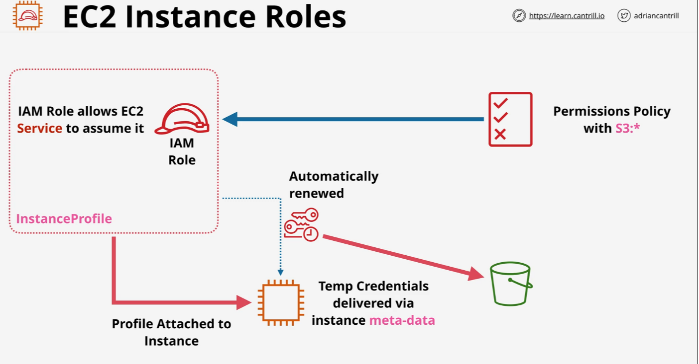
EC2 Instance Roles

Slide 7
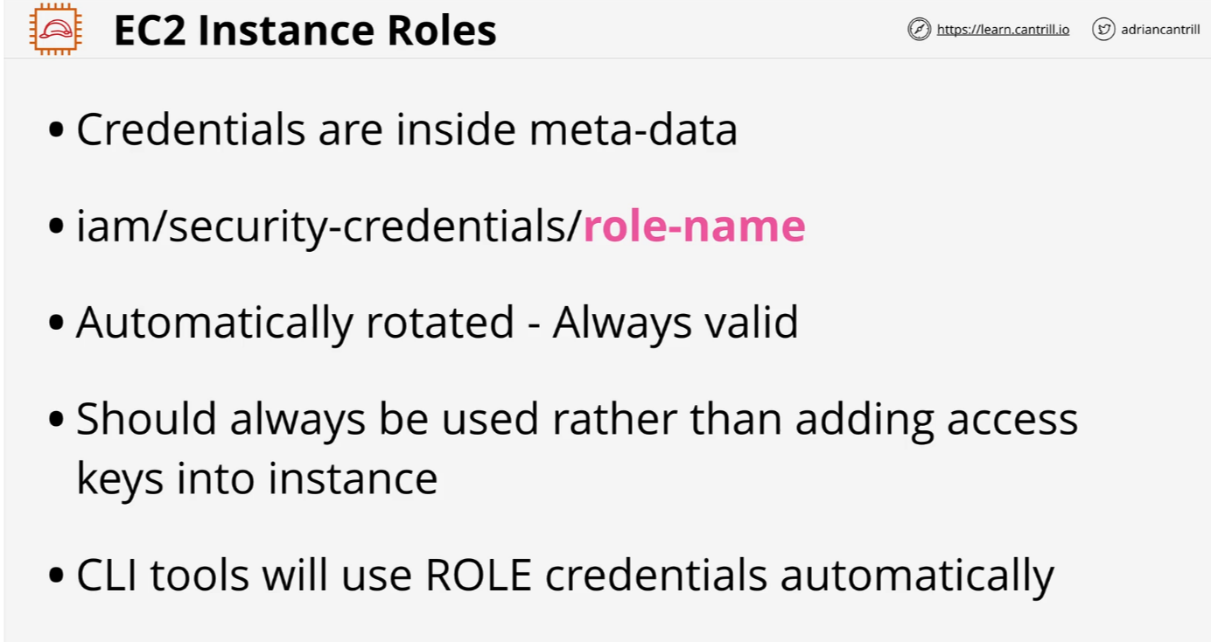
EC2 Instance Roles

Slide 8
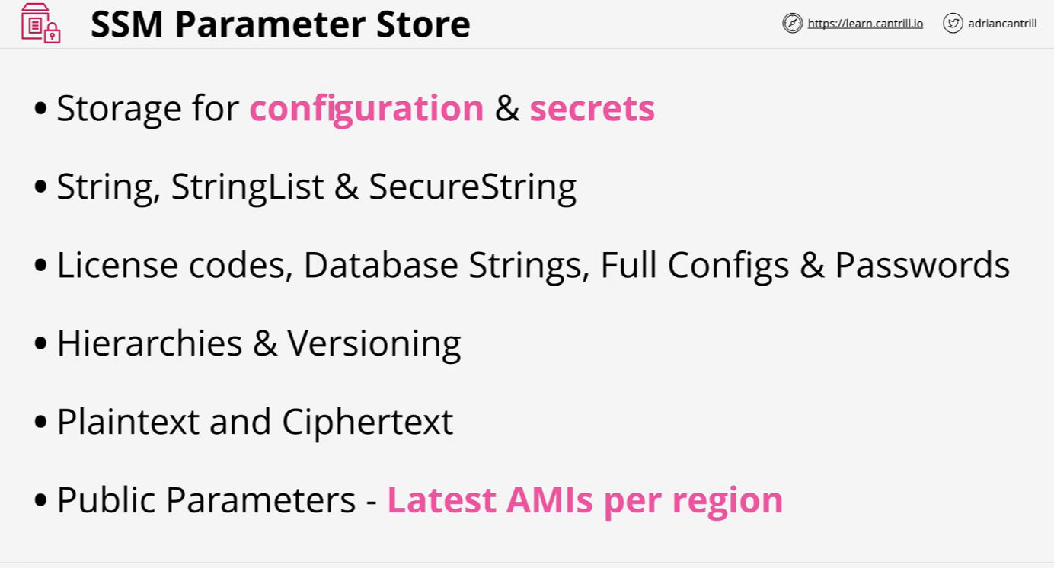
SSM Parameter Store

Slide 9
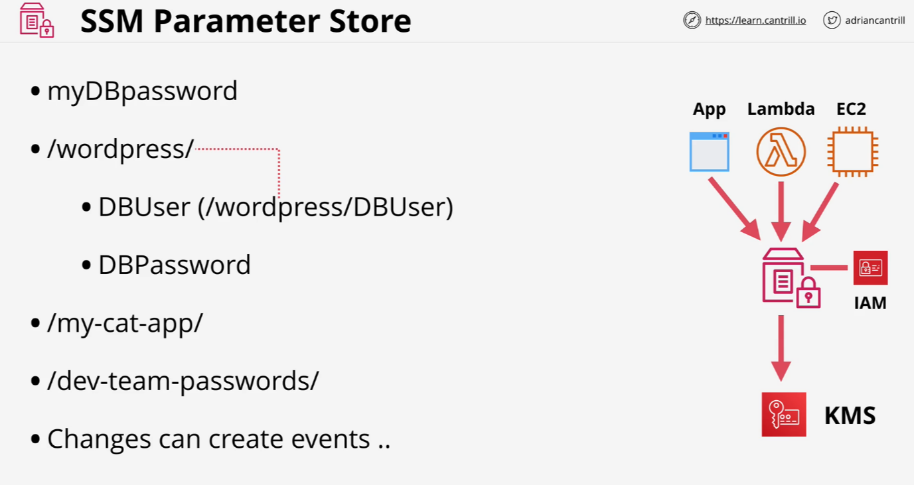
SSM Parameter Store

Slide 10
[DEMO] Parameter Store
https://learn-cantrill-labs.s3.amazonaws.com/awscoursedemos/0012-aws-associate-ec2-parameter-store/lesson_commands.txt

Slide 11
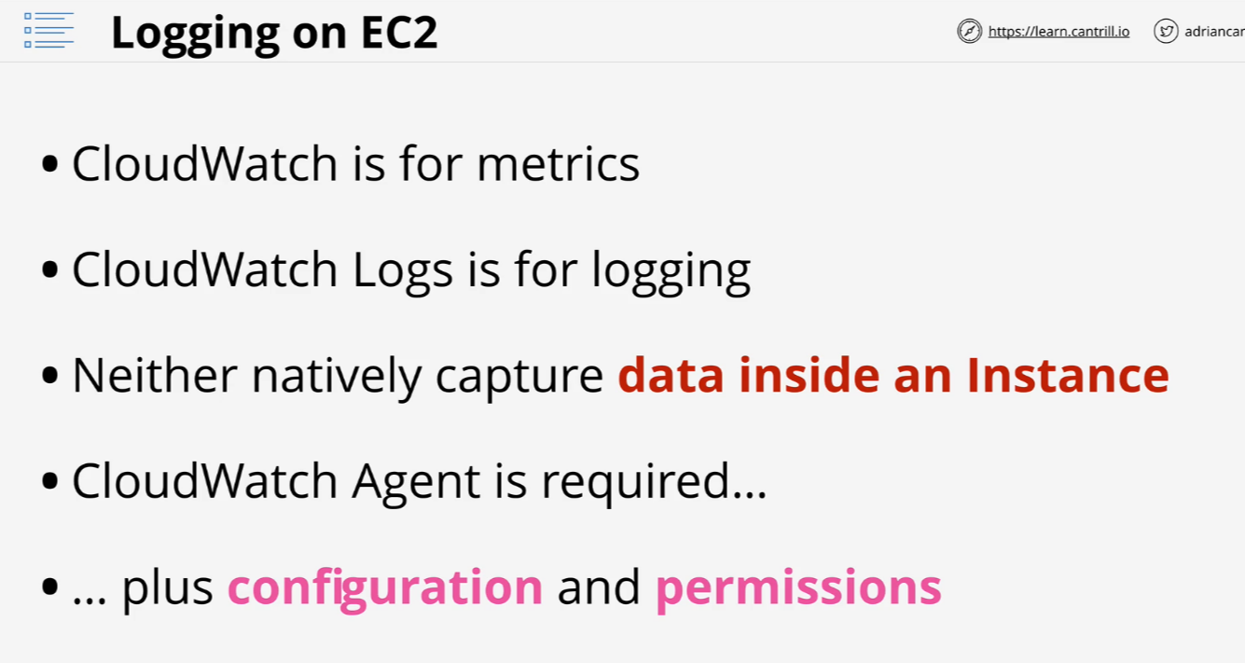
System and Application Logging on EC2

Slide 12
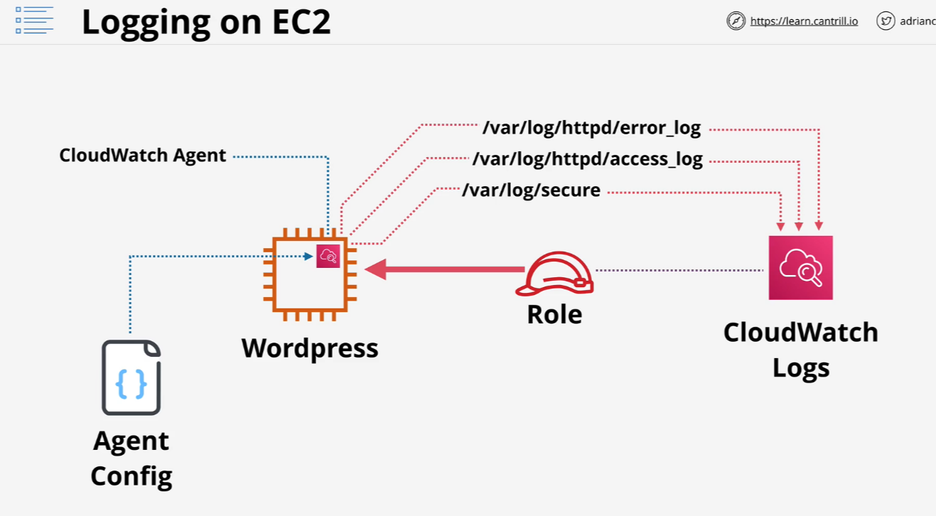
System and Application Logging on EC2

Slide 13
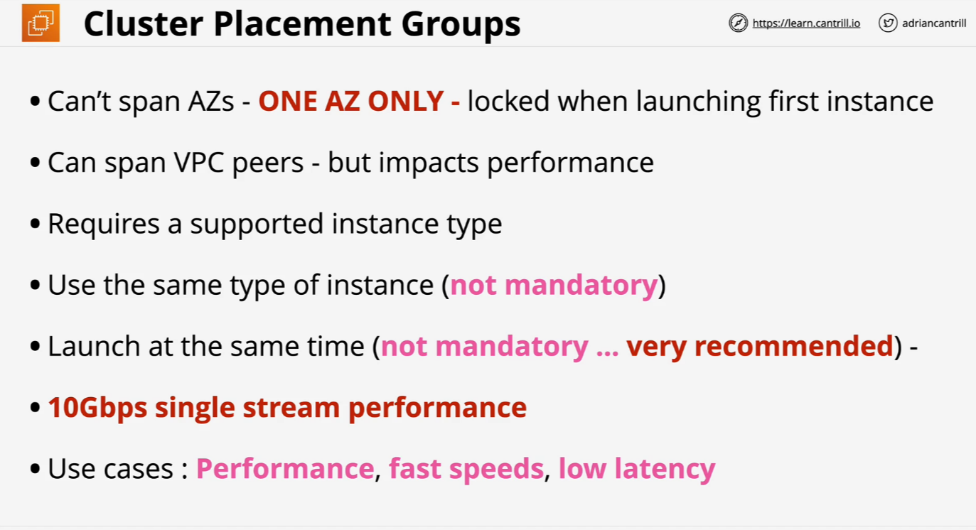
EC2 Placement Groups

Slide 14
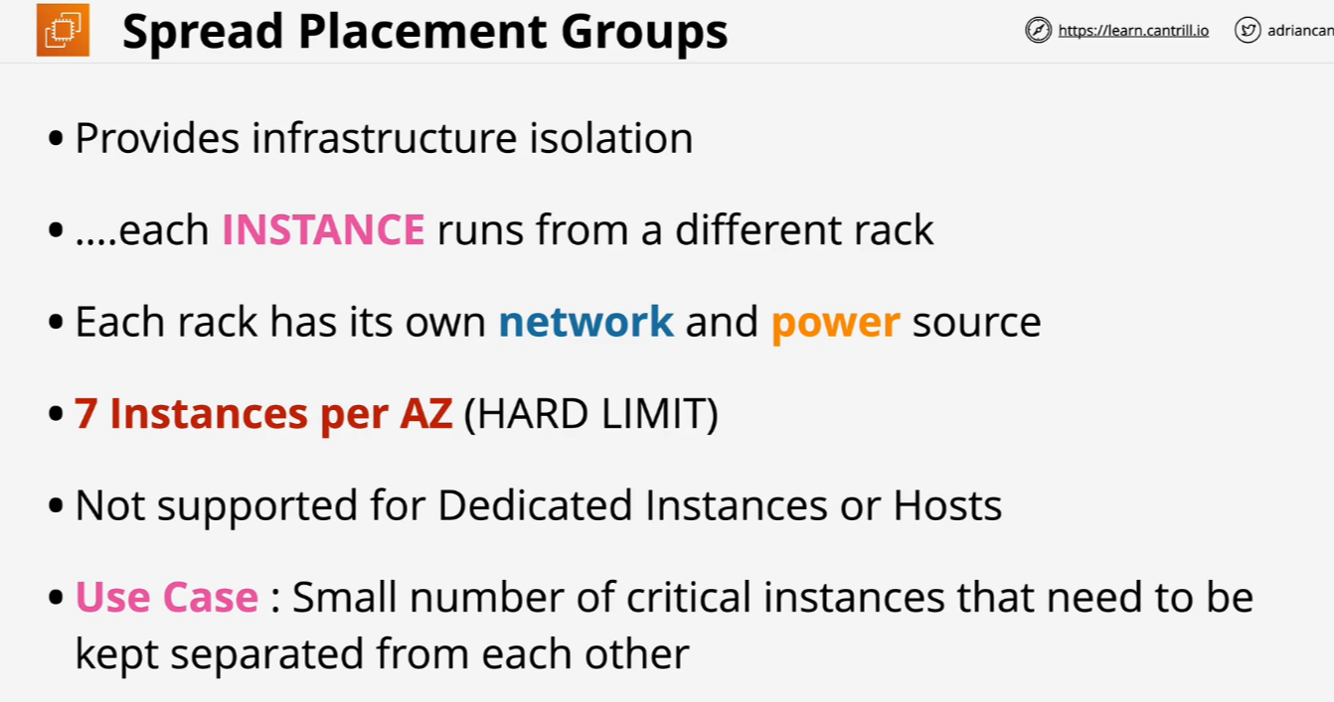
EC2 Placement Groups

Slide 15
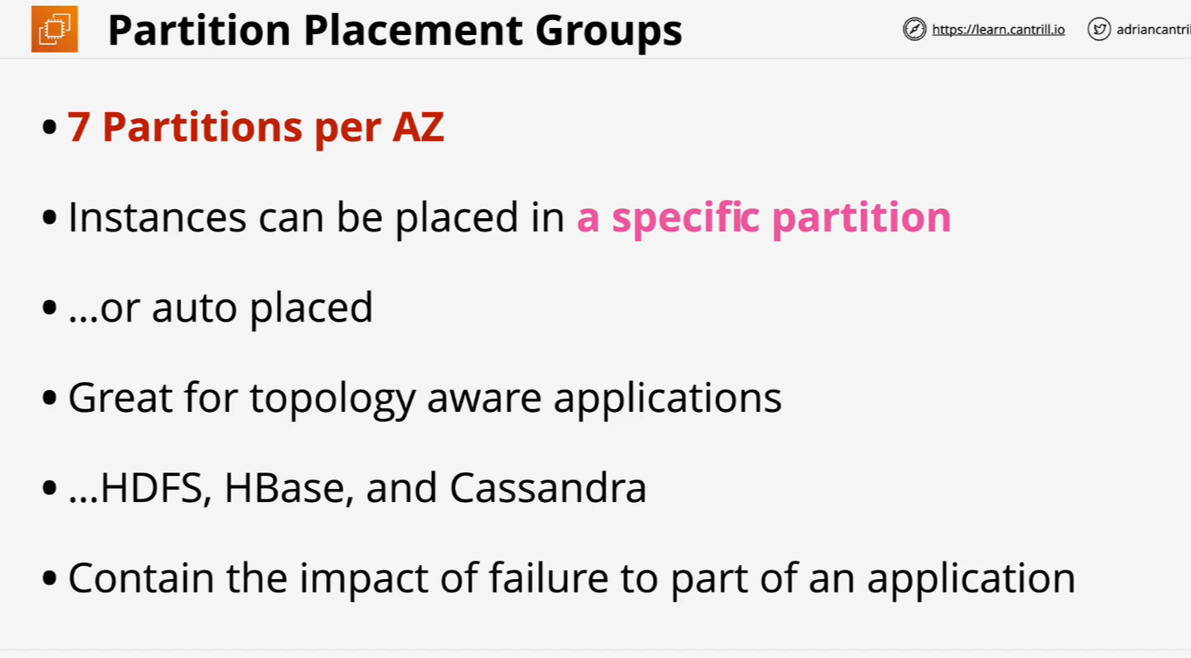
EC2 Placement Groups

Slide 16
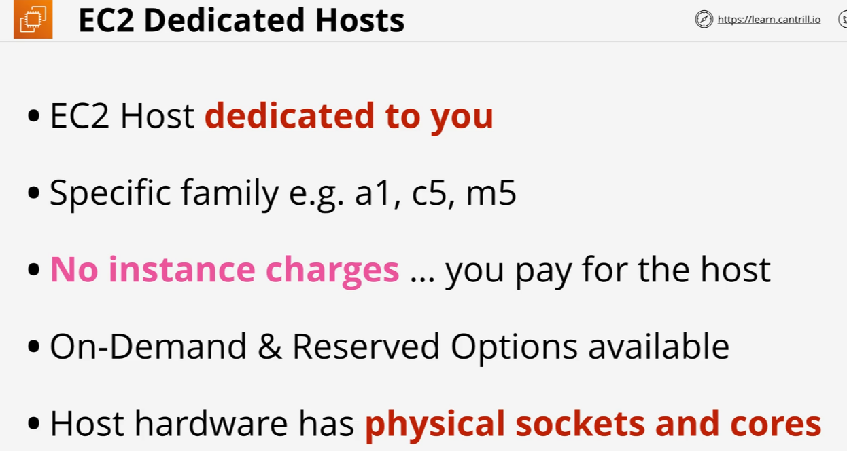
Dedicated Hosts

Slide 17
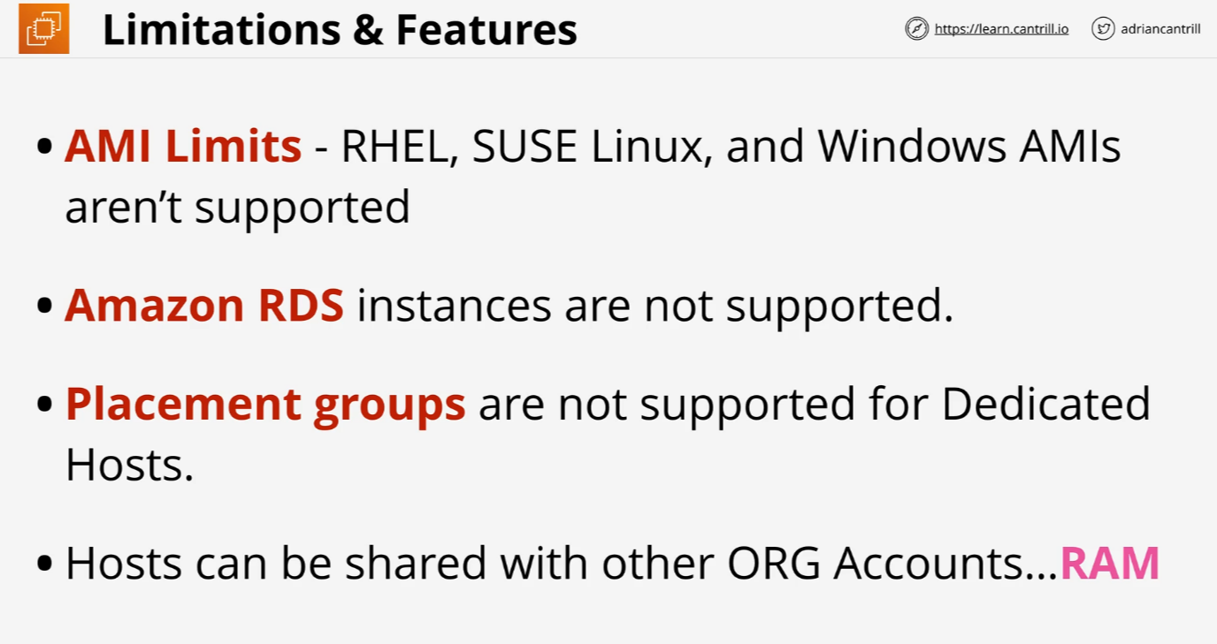
Dedicated Hosts

Slide 18
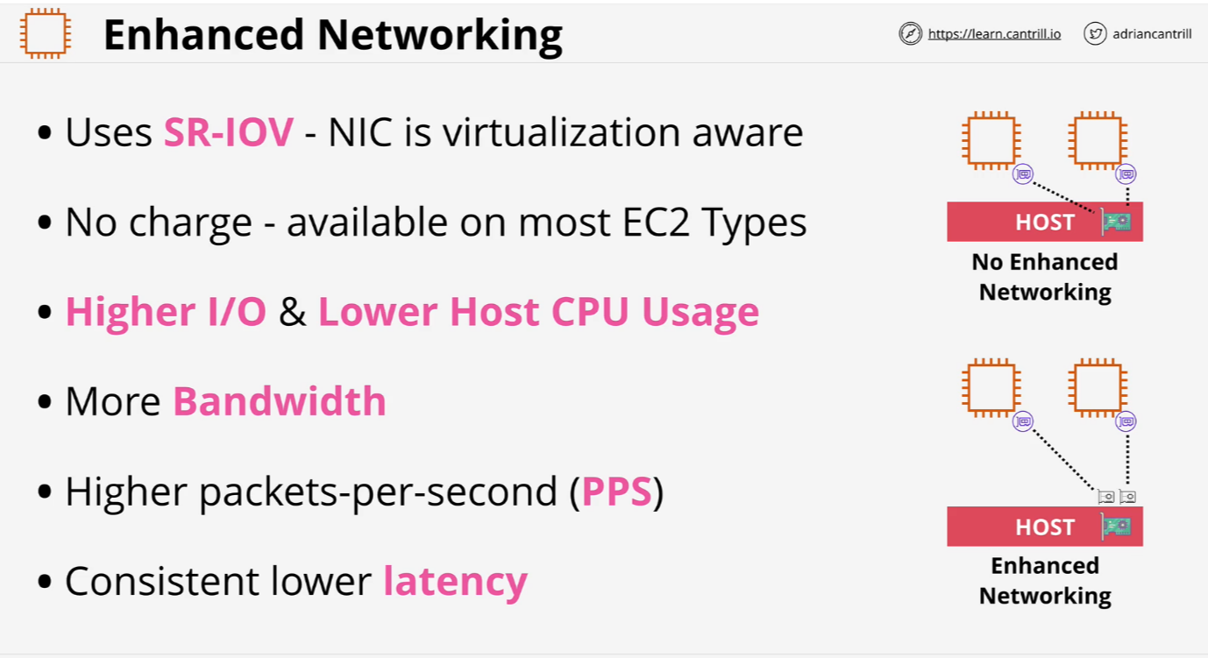
Enhanced Networking

Slide 19
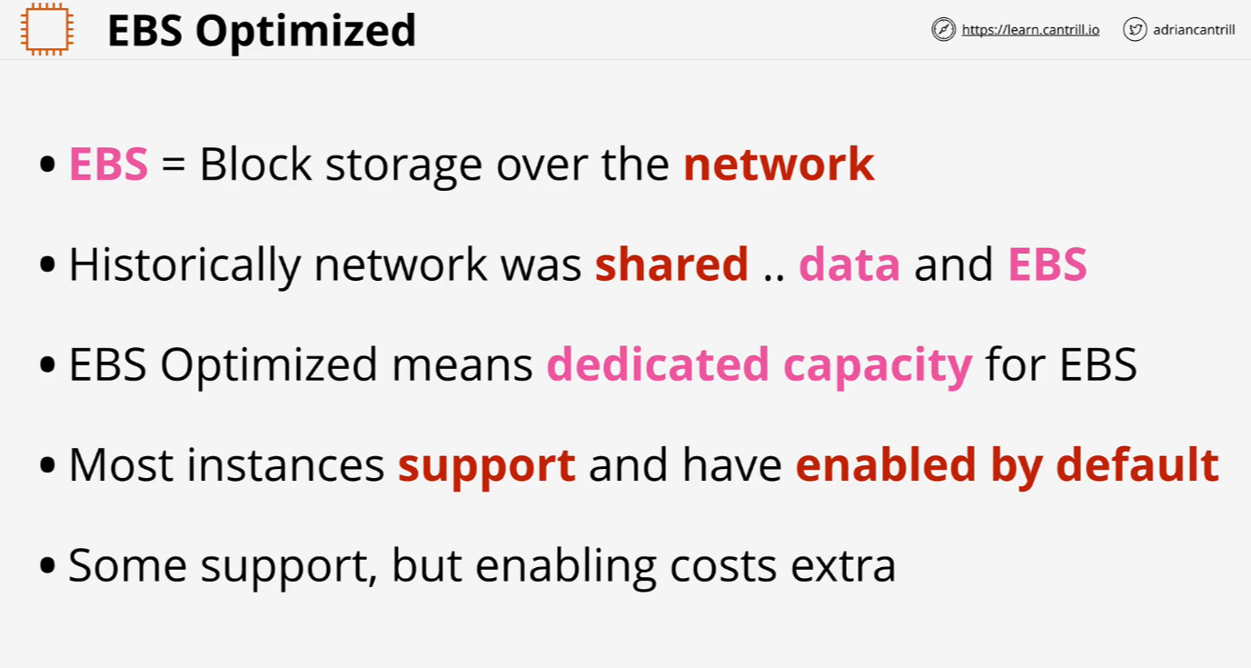
EBS Optimized

